Slide 1
Highland Ditch Water Right and Fish Protection Project
Highland Ditch is a legacy 1911 water right diversion for irrigation purposes.
There are eleven water right stakeholders. Rights are based on property acreage size ranging from 80 to 3 acres.
Currently the right is estimated to be at 2.9 CFS from May to October
The ditch is in poor condition with considerable degradation of infrastructure. There is insufficient control of diverted water resources and a chronic problem determined by OWRD.
In 2020 State Police and ODFW discovered well over 190 dead juvenile ESA listed Coho salmon in the ditch. ODFW staff considered these losses to have been taking place for years. The State has given the stakeholders one year to resolve water resource misappropriation and fish kills.

Slide 2
Highland Ditch Water Right and Fish Protection Project
surcp.org is currently working with landowners to form a formal association of stakeholders.
There is currently an informal association with officers and landowner participants.
ODFW has installed a temporary fish screen and has contracted with association officers to keep the trap clean. They have committed to cover a large portion of a permanent fish screen costs.
ODWR is closely monitoring water utilization and has already issued a warning again this year.
Landowners are committed to assist with equipment and work force participation if needed.
Surcp has a spreadsheet of landowner names and water allocation right.

Slide 3
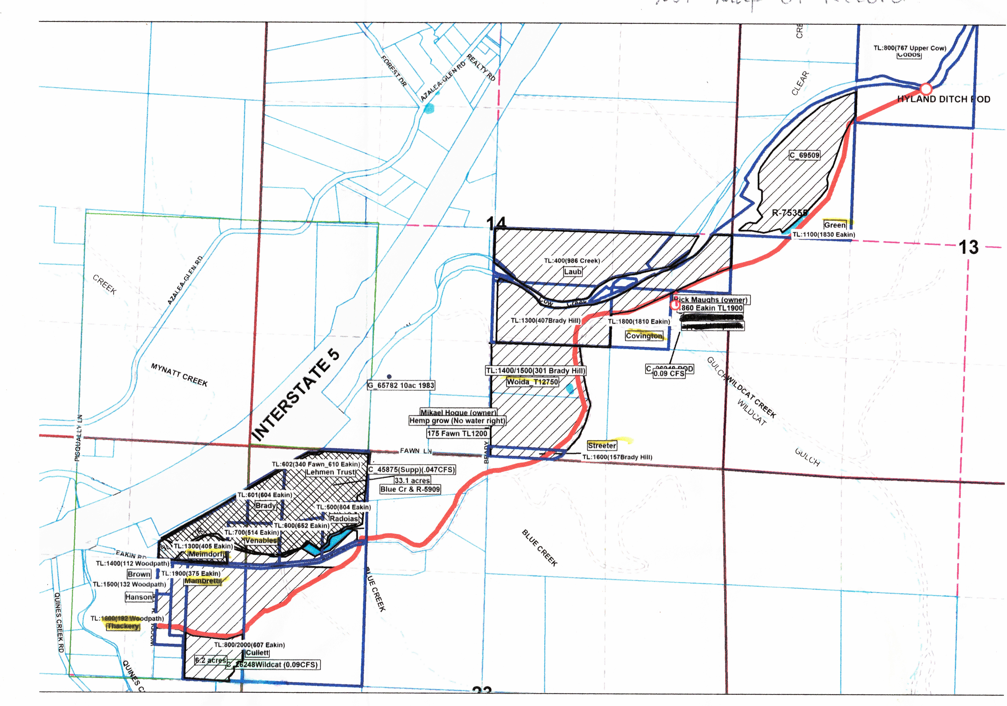
Highland Ditch
Landowner Plot Map

Slide 4
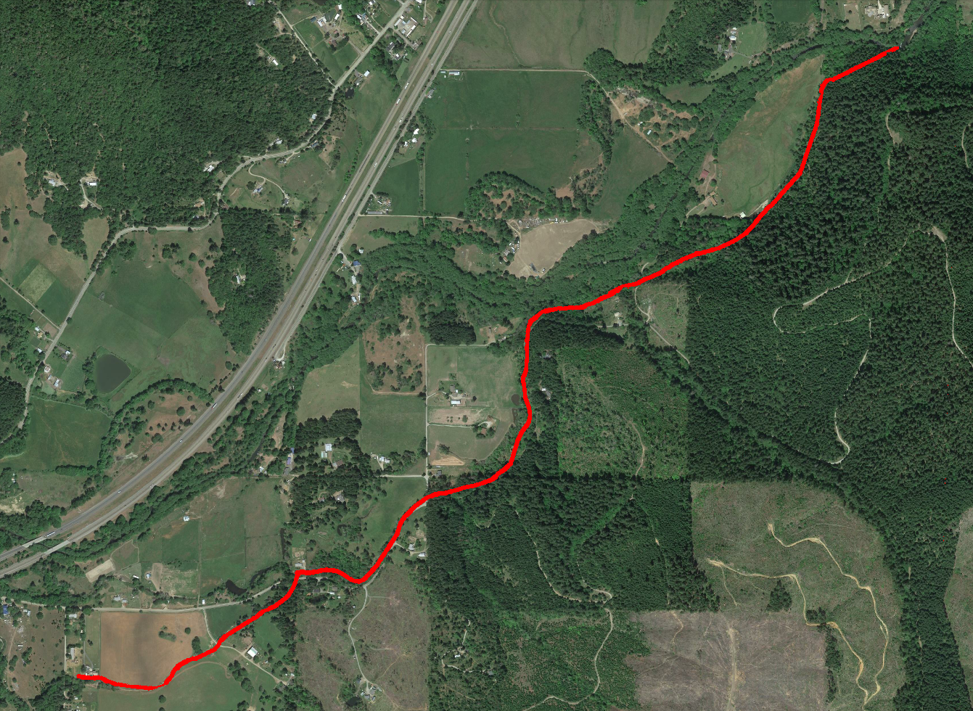
Path Map 2.3 miles from diversion to termination point

Slide 5
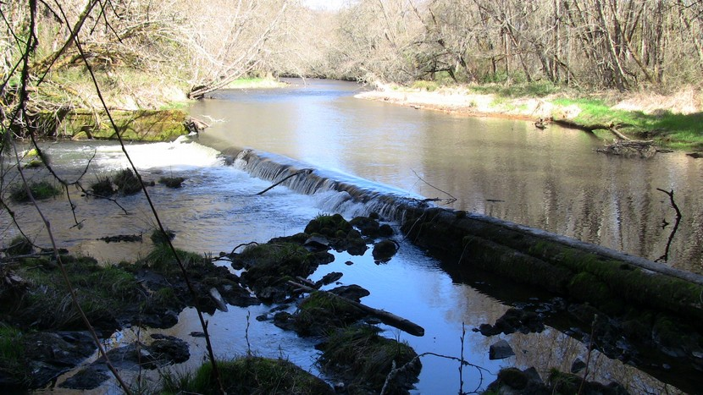
Diversion Dam

Slide 6
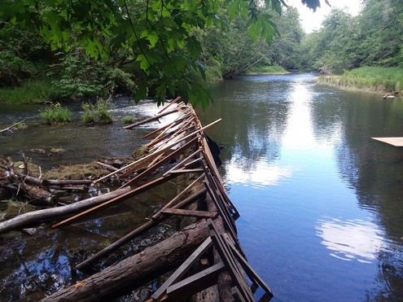
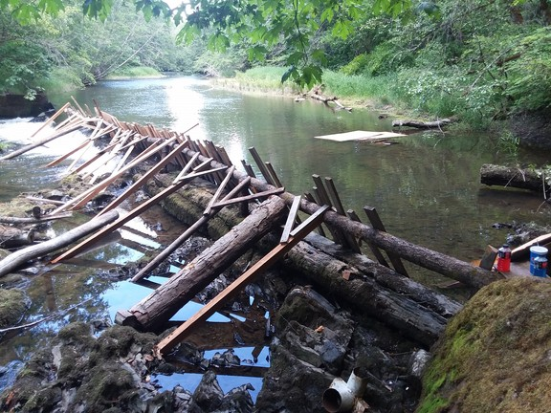
Diversion Dam In Use

Slide 7
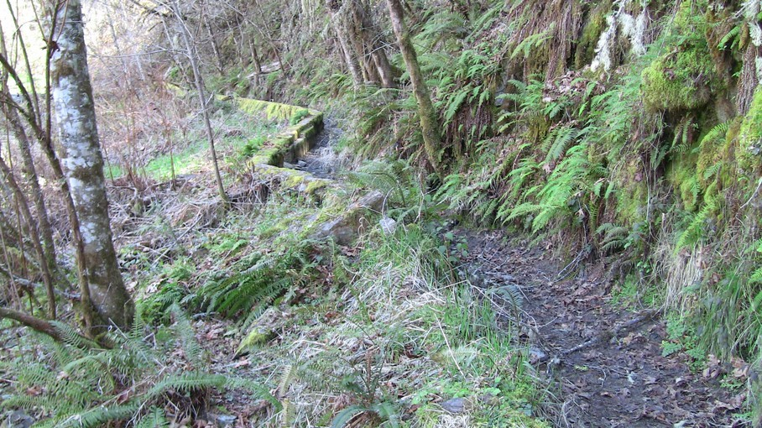
Ditch concrete channel and first breach point

Slide 8
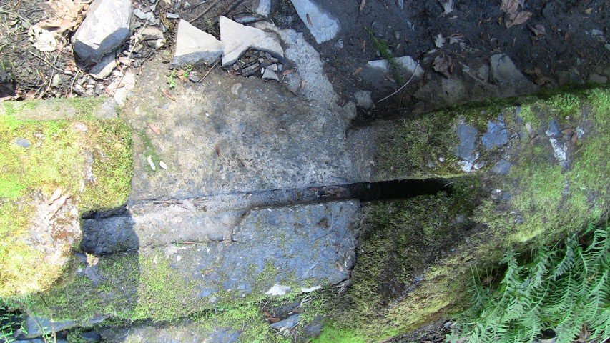
One of many water control slots

Slide 9
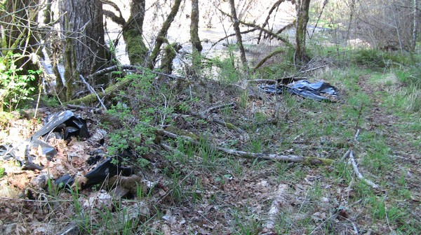
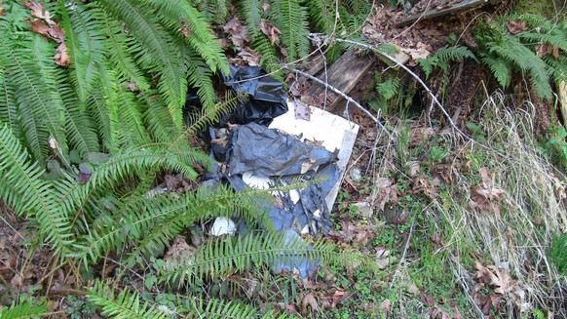
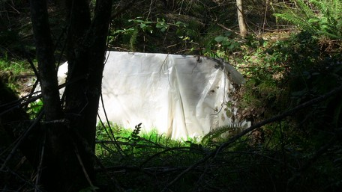
Examples of perennial plastic water management debris

Slide 10
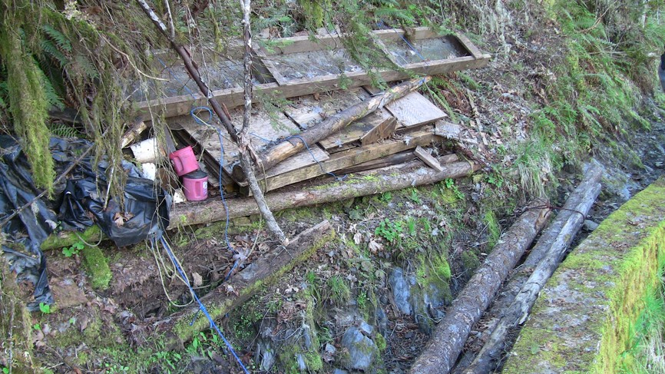
Current fish screen and related equipment

Slide 11
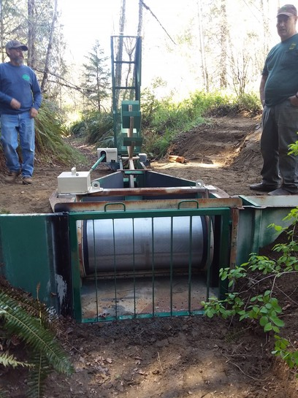
Temporary fish screen

Slide 12
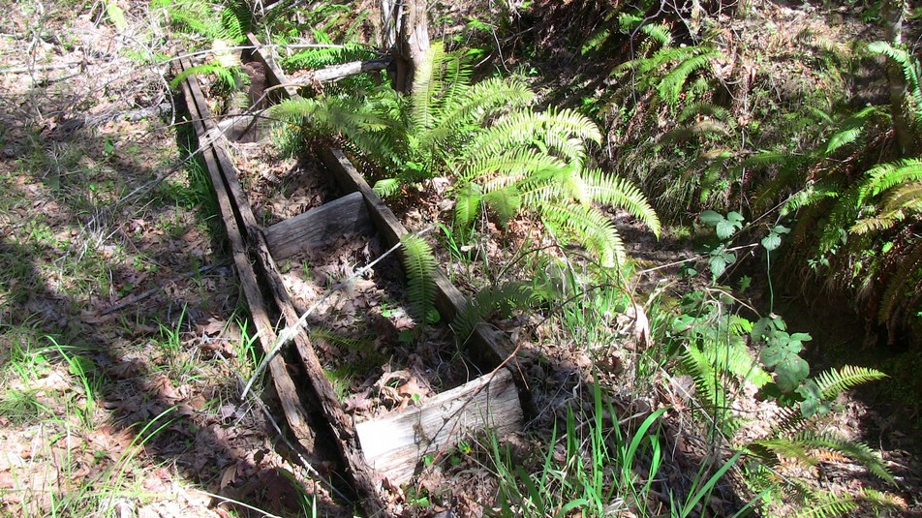
Original screen washed out down the ditch

Slide 13
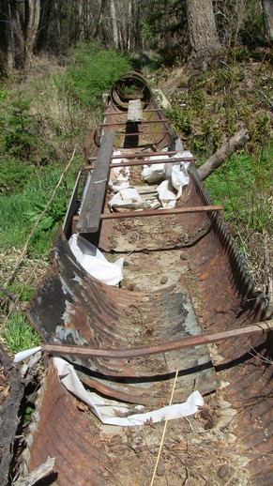
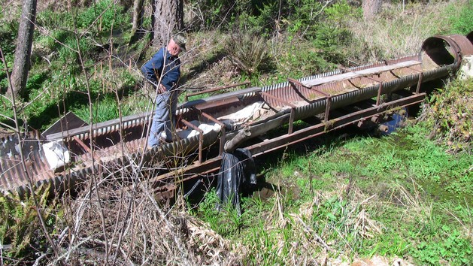
Main flume for fish release if they are entrapped in the ditch. Plastic sheet indicates release hole opening
image 1

Slide 14
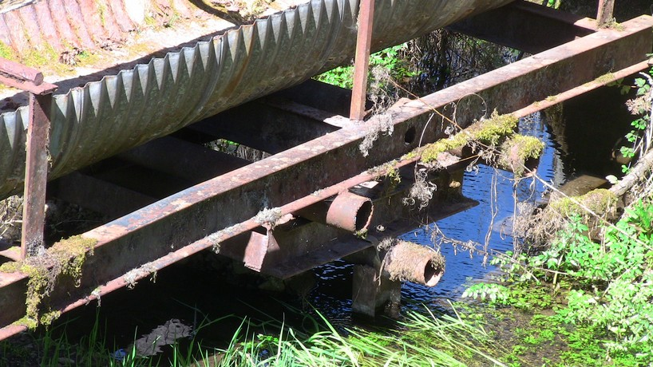
Fish release flume support

Slide 15
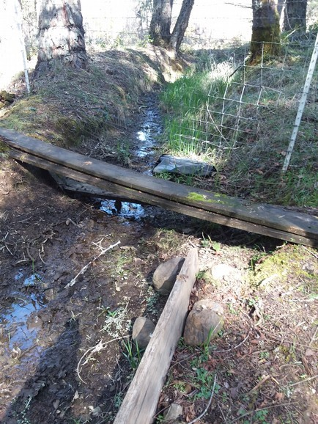
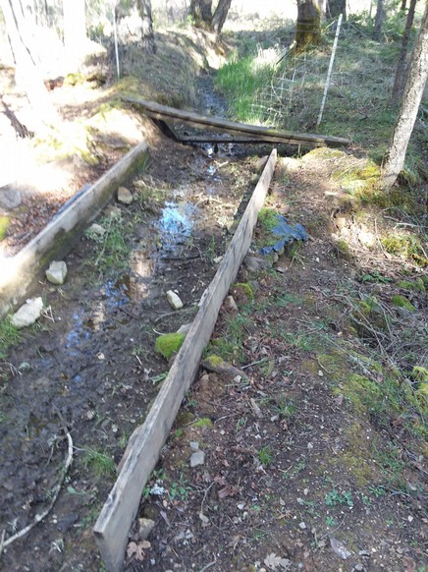
Blue Creek Flume!

Slide 16
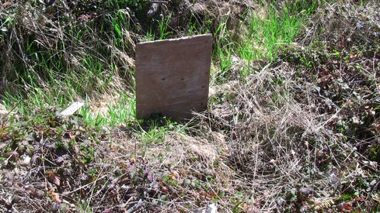
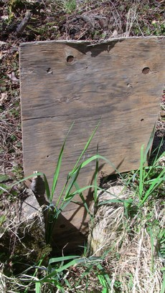
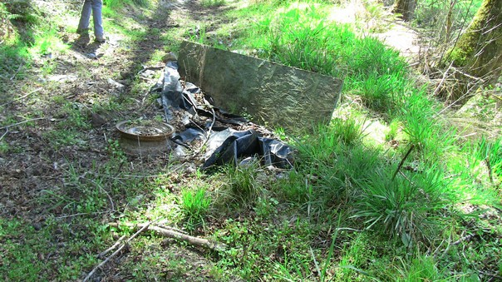
Ditch irrigation water release sites

Slide 17
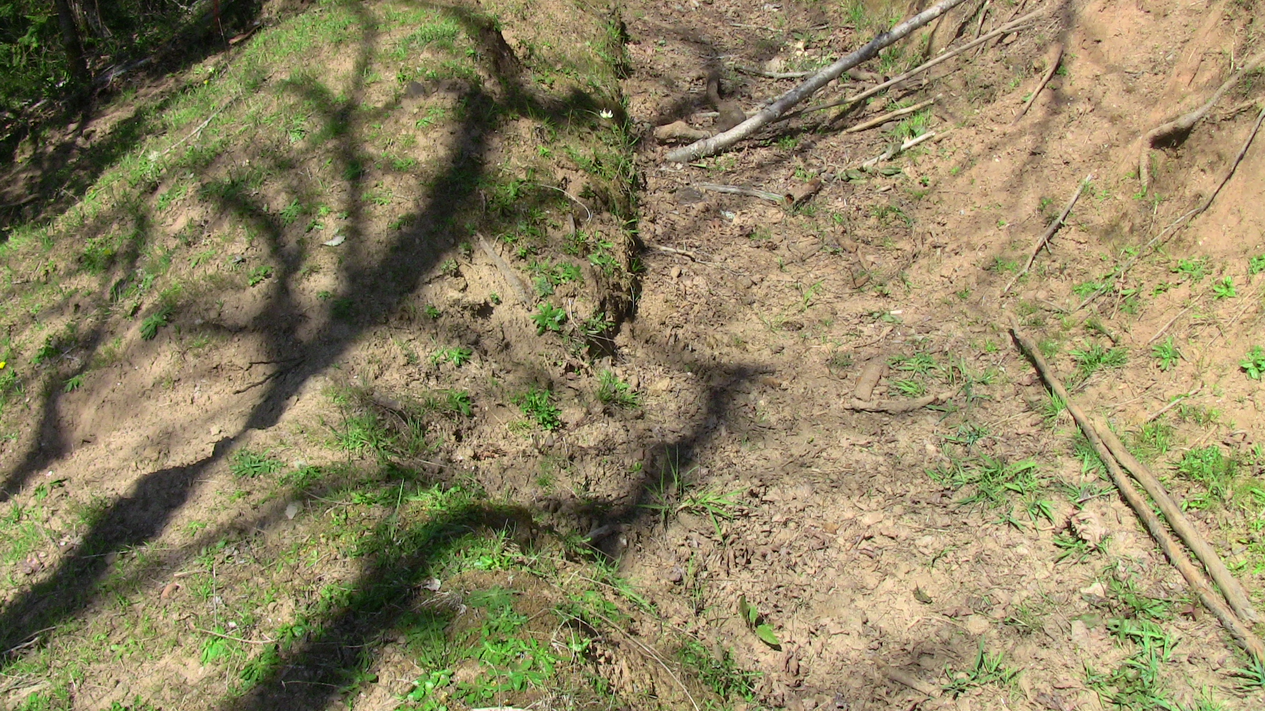
Example of ditch breach caused by elk.

Slide 18
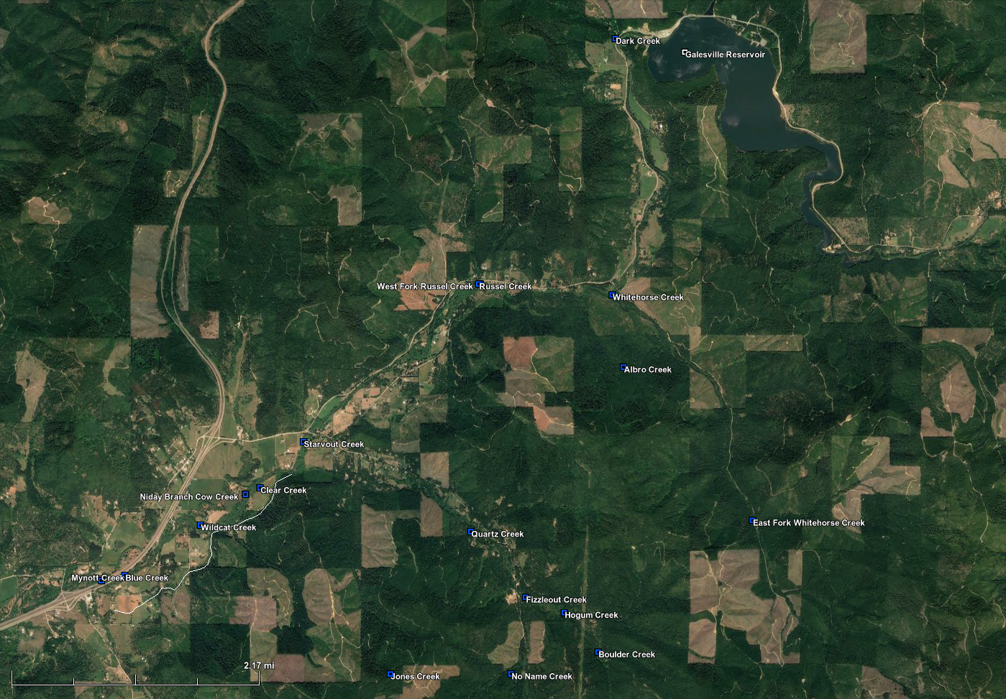
Project Site Overview
Highland Ditch ESH Habitat Impact

Slide 19
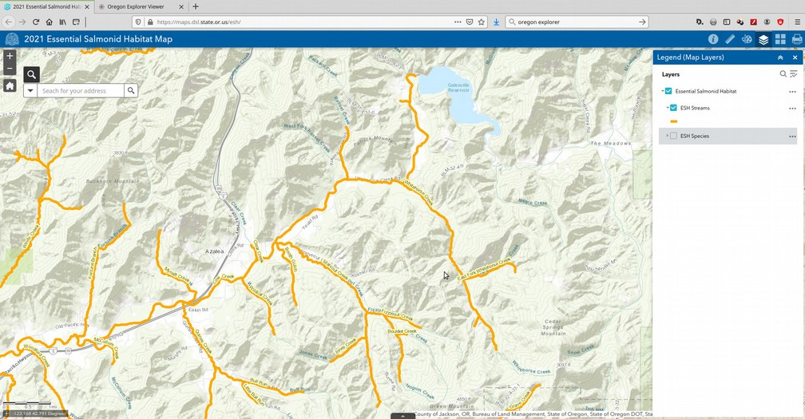
Project Site Overview
Highland Ditch ESH Habitat Impact

Slide 20
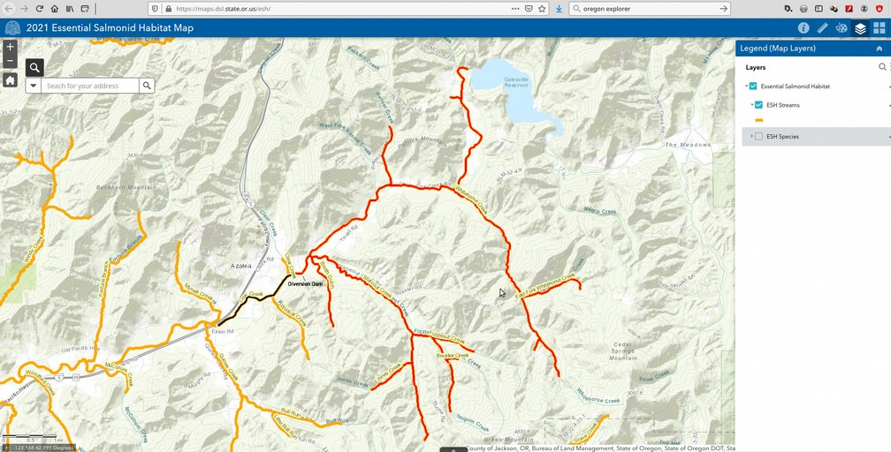
Project Site Overview
Highland Ditch ESH Habitat Impact

